Slide 1

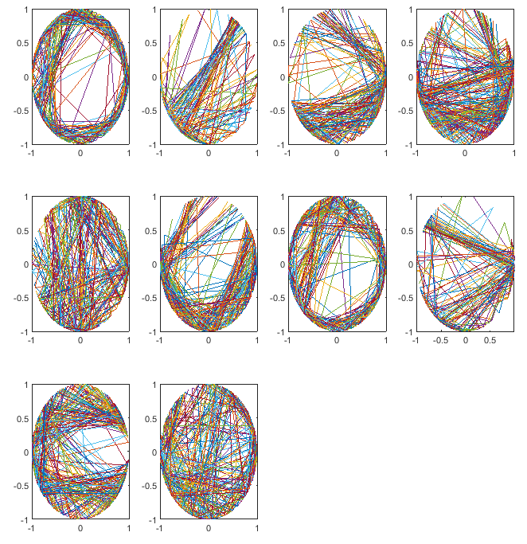
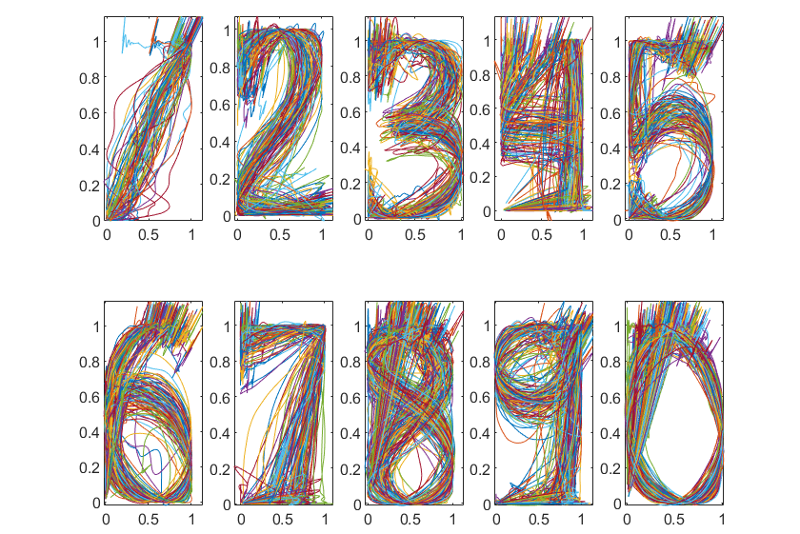
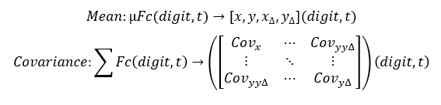
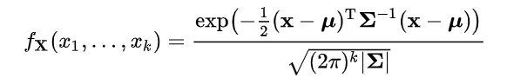
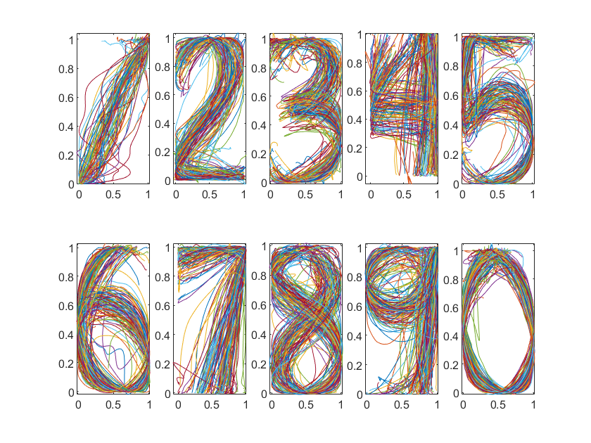
Imrich Stoffa – 0539875
Nima Bahmani – 0533855
Pablo Castro – 0539419
Digits 3-D
Pre-processing
Processing
Models
Classification
Results
Sample rate = 50
Performance = 96.5%
Graph of delta of signals, normalized, xd vs yd. Digits 0-9 left to right line by line.
10 samples per signal

